Slide 1
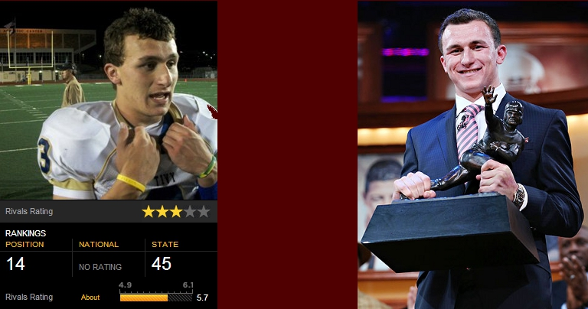
Recruiting Battles
By: Da Xin

